Slide 1
Learning IPv4 Routes with RIPv2
Liu Cui

Slide 2
RIP and Routing Protocol Concepts
Many IP routing protocols exist, in part due to the long history of IP. However, if you compare all the IP routing protocols, they all have some core features in common. Each routing protocol causes routers to
1. Learn routing information about IP subnets from other neighboring routers
2. Advertise routing information about IP subnets to other neighboring routers
3. If a router learns of more than one route to reach one subnet, choose the best route based on that routing protocol’s concept of a metric
4. React to changes when the network topology changes –for example, when a link fails, and converge to use a new choice of best route for each destination subnet.

Slide 3
Distance Vector (Routing algorithm for RIP)
When a router learns about a route to a subnet, the routers learn three important facts:
The destination subnet
The distance: routing protocol metric
Vector: the link and next-hop router to use as part of that route
Spilt Horizon
When sending out the update, interface X omits routes that would use interface X as the outgoing interface.
Route Poisoning
Advertise the failed route by using a infinity value.

Slide 4
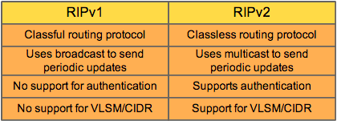
RIPv1 and RIPv2

Slide 5
Configuring Core RIPv2 Features
Step 1: Use the router rip command in global configuration mode to move into RIP configuration mode.
Step 2: Use the version 2 command in RIP configuration mode to tell the router to use RIP Version 2 exclusively
Step 3: Use one or more network net-number commands in RIP configuration mode to enable RIP on the correct interfaces.

Slide 6
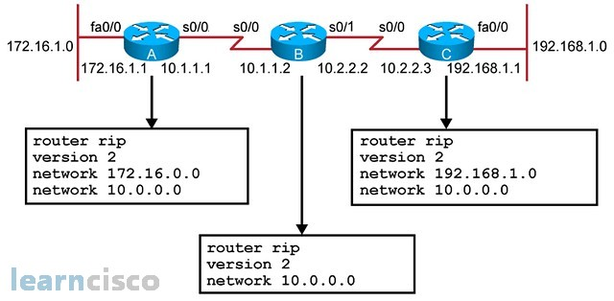
Configuring Core RIPv2 Features

Slide 7
RIP Verification
Command | Purpose
show ip route [rip] | Routes: This command lists IPv4 routes as learned by RIP. The show ip route command lists all IPv4 routes, and the show ip route rip command lists RIP-learned routes only
show ip protocols | Configuration: This command lists information about the RIP configuration, plus the IP addresses of neighboring RIP routers from which the local router has learned routes.
show ip rip database | Best routes: This command lists the prefix/length of all best routes known to RIP on this router, including routes learned from neighbors and connected routes for interfaces on which RIP has been enabled.

Slide 8
Comparing Routing Sources with Administrative Distance
When an internetwork has redundant links and uses a single routing protocol, each router may learn multiple routes to reach a particular subnet. That one routing protocol then uses a metric to choose the best route, and the router adds that route to its routing table.
However, some enterprises use multiple IP routing protocols. On router might learn of multiple routes to a particular subnet using different routing protocols. In these cases, the metric does not help the router choose which route is best, because each routing protocol uses a metric unique to that routing protocol.
The router still needs to choose the best route even between routes learned by different routing protocols, or between routing protocols and static routes. IOS solves this problem by assigning a numeric value to each routing protocol, called administrative distance.

Slide 9
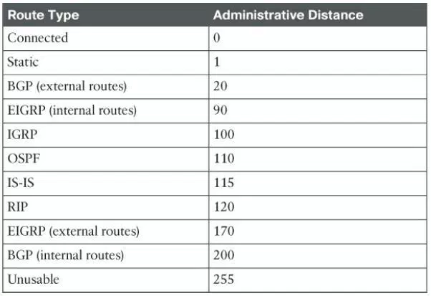
Comparing Routing Sources with Administrative Distance

Slide 10
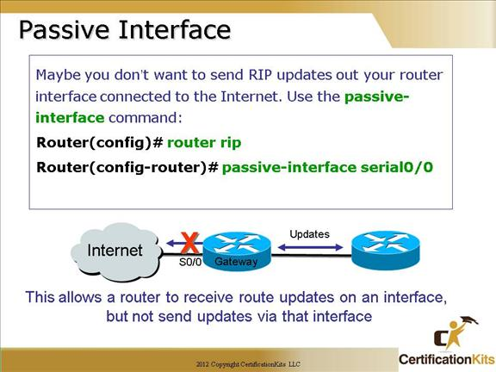
Optional RIPv2 Configuration and Verification
Controlling RIP Updates with the passive-interface Command
In some cases, you want to enable RIP on an interface so that you can advertise about the connected subnet, but you do not need to advertise routes on that interface.
The RIPv2 passive-interface command can be used to stop all RIPv2 updates from being sent out the interface that is matched by a network command.

Slide 11
Optional RIPv2 Configuration and Verification
Supporting Multiple Equal-Cost Routes with Maximum Paths
With RIP’s hop-count metric, ties can easily happen.
RIP’s default behavior when it learns more than one route that ties is to put multiple routes into the routing table and use them all (load balancing).

Slide 12
Troubleshooting
Missing and incorrect network command
The router does not advertise about the subnets on those interfaces
The router does not exchange routing information with other routers on those interface
Incorrect Passive interfaces
The passive-interface feature should never be used on an interface that connects to another RIP router. However, if one router is incorrectly configured to be passive, whereas a neighboring router is not, the passive router still hears RIP updates, while the correctly configured router does not hear updates.

